Slide 1
Project Poirot
Machine Learning based Predictive Crime Analysis
Team:
Mansi Ganatra(4669963813)
Naga Ritwik Indugu(7042923484)
Uma Kanumuri(5340531435)
Mentors:
Prof. Ion Muslea
Officer Wyman Thomas (USC DPS)

Slide 2
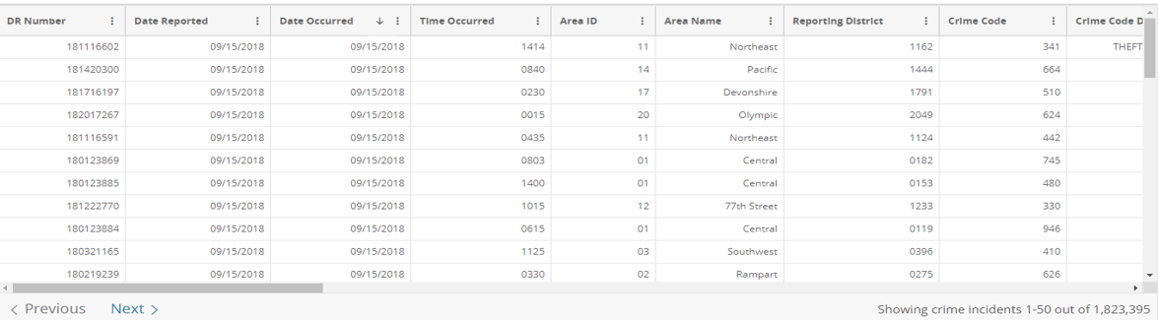
Data Source & Implementation Details
Los Angeles Open Data: Crime Data from 2010 to Present(https://data.lacity.org/A-Safe-City/Crime-Data-from-2010-to-Present/y8tr-7khq), cleaner version of it from https://www.kaggle.com/cityofLA/crime-in-los-angeles
Size: ~ 1.4million records
Previous Work: https://www.crimemapping.com/map/ca/losangeles, http://www.predpol.com/
Sample:
Technologies: python, scikit-learn, keras, seaborn, matplotlib
Code: https://github.com/mansiganatra/project-poirot.git

Slide 3
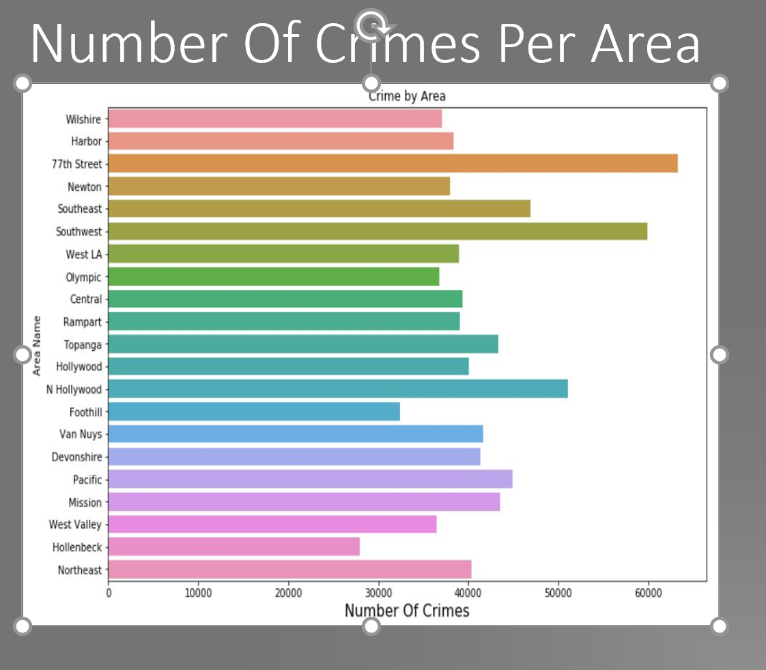
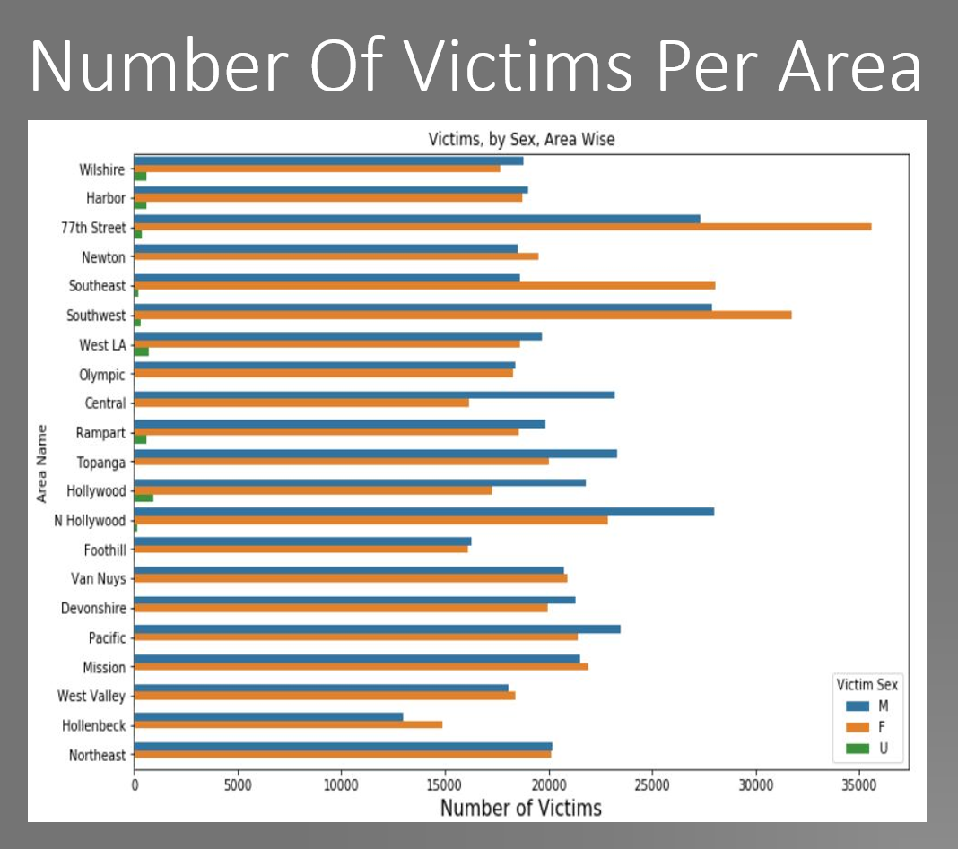
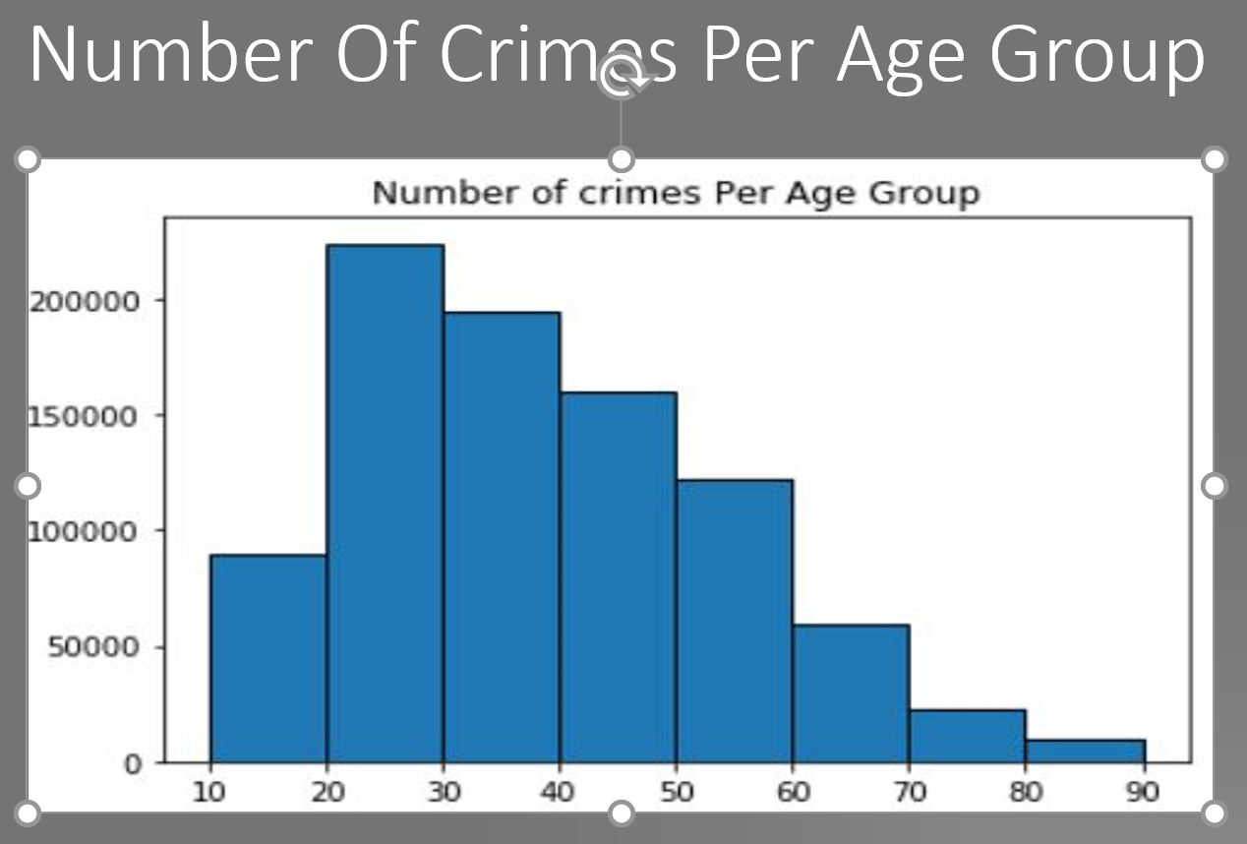
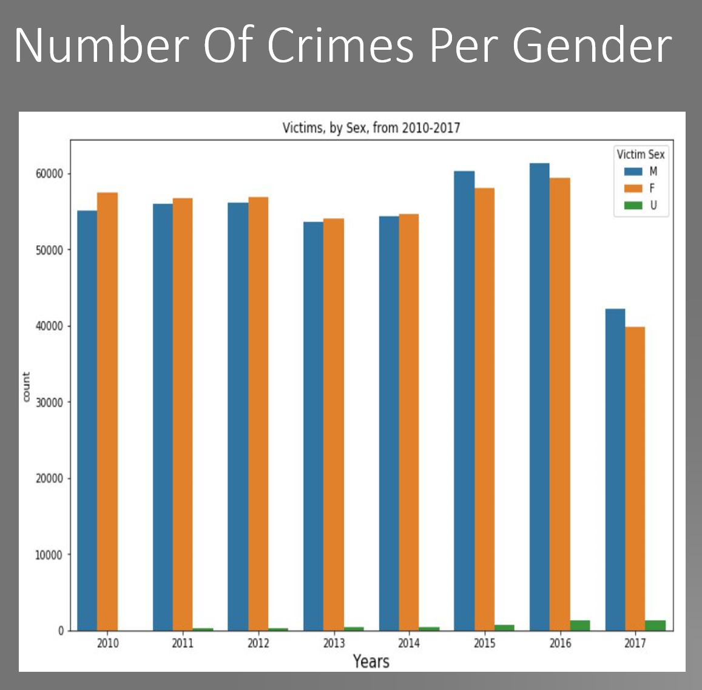
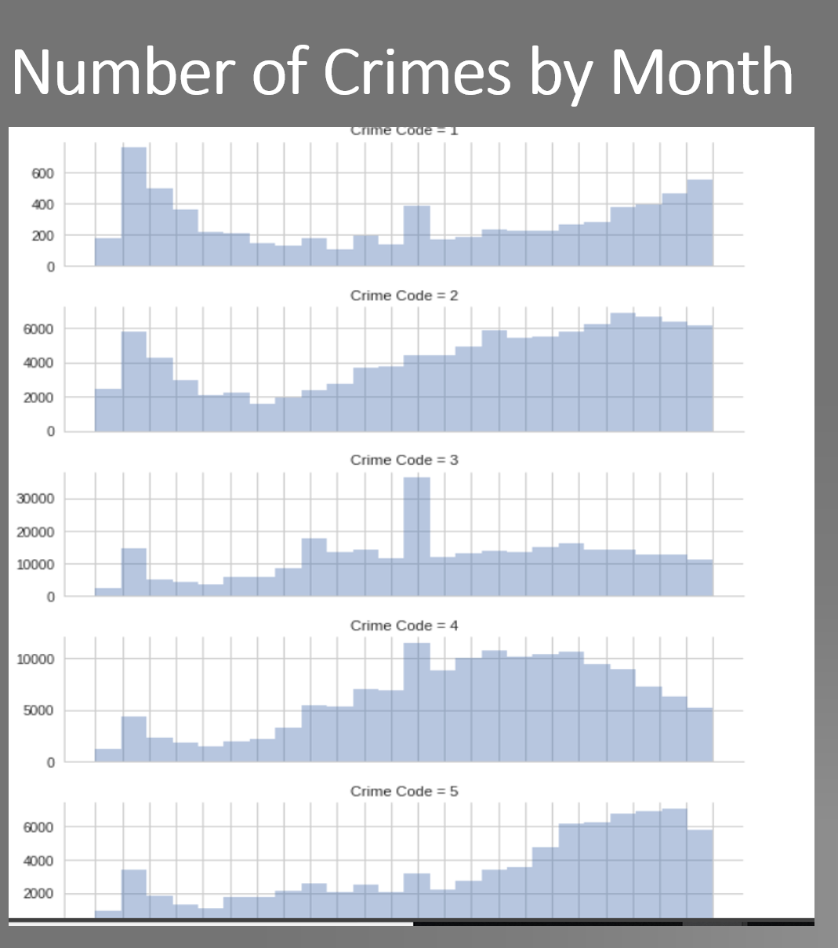
Exploratory Data Analysis

Slide 4
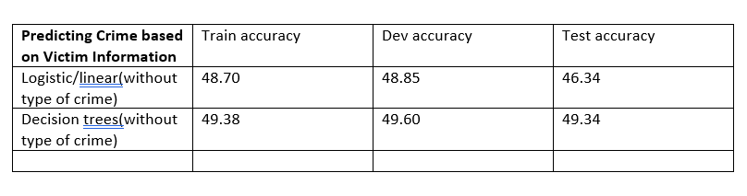
Predicting Crime based on Victim Information
Given victim information: age, sex, descent in the dataset, we tried to predict the crimes they are likely to be targeted by.
Our models do not use the victim descent information, although the information is present in the dataset. Also, the information present in the dataset in anonymous and cannot be used to identify individuals.

Slide 5
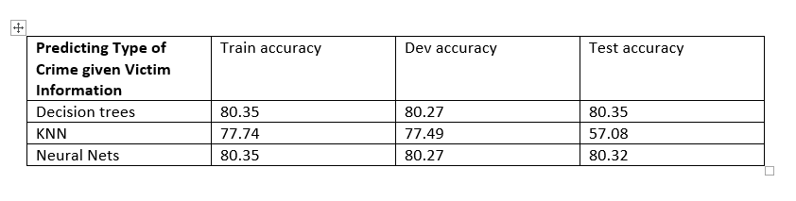
Predicting Type of Crime given Victim Information
Given the lower accuracies our models obtained in predicting crime codes in the previous models, we decided to categorize time into: Property and Personal crimes.
Notes:
We labeled the data manually with the help of domain knowledge received from Officer Wyman Thomas.

Slide 6
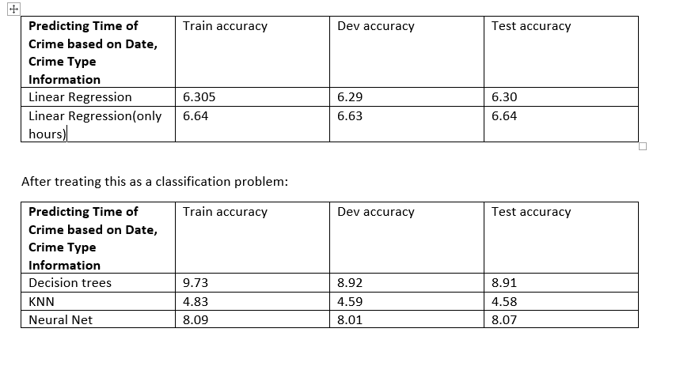
Predicting Time of Crime based on Date, Crime Type Information
Given the date of crime(used to extract day, month, season information) and the crime code, we tried to predict the time at which a crime was more likely to occur.
We initially treated time as a linear variable to be predicted by regression. Later we explored treating the problem as a classification problem.

Slide 7
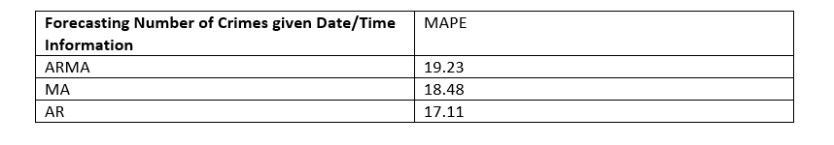
Forecasting Number of Crimes given Date/Time Information
The inherent patterns in the frequency of each crime made predicting time difficult. For example, regardless of day/month/year Thefts remained to be the most common crime while Sexual Assaults the least common. Hence we decided to run time-series analysis to forecast the number of crimes.
Notes:
We labeled the data manually with the help of domain knowledge received from Officer Wyman Thomas.

Slide 8
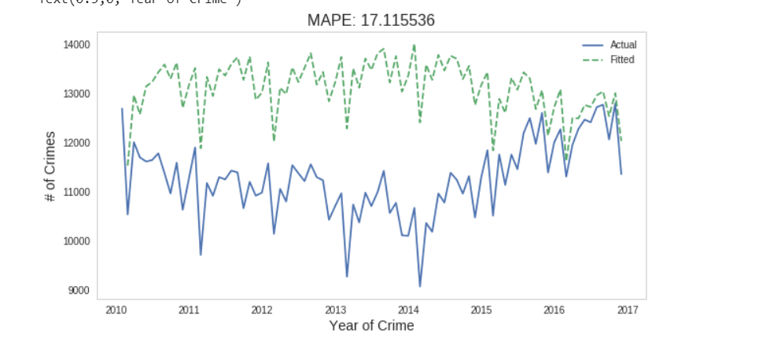
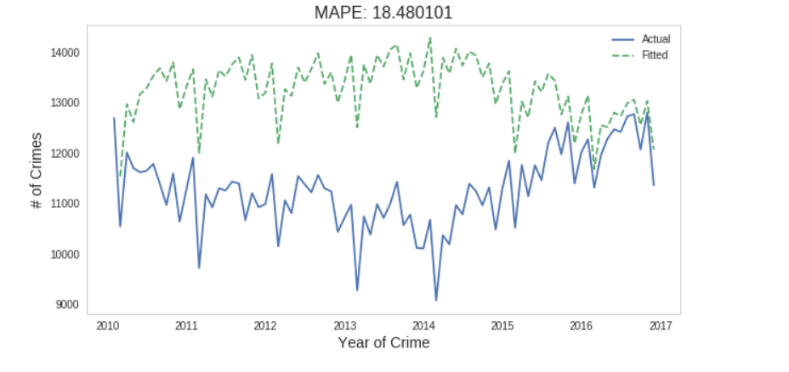
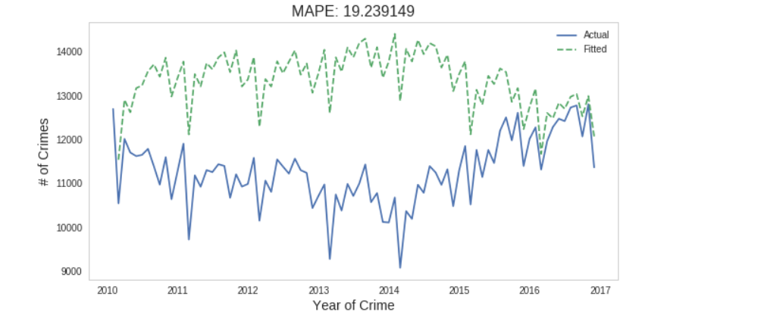
Forecasting Number of Crimes given Date/Time Information
Notes:
We labeled the data manually with the help of domain knowledge received from Officer Wyman Thomas.

Slide 9
Comparison to Previous Work
Even after much efforts, we were unable to find relevant work which we could compare to for performance. Except PredPol.
PredPol is a proprietary software based on the paper “”, but they do not make the performance information of the algorithm publically available.
Notes:
We labeled the data manually with the help of domain knowledge received from Officer Wyman Thomas.

Slide 10

Questions/ Suggestions

